Slide 1
Financial Loan Default Prediction

Slide 2
Catalog
Project Introduction
Data Cleaning
Feature Engineering
Modeling
Conclusion

Slide 3
Project Introduction
Loan Default Prediction Challenge
The project comes from the competition of Ali Tianchi.
It requires contestants to build models to predict financial risks based on a given training data set and make a test in testing data set.
Evaluation Metric
The competition uses AUC as the evaluation metric. AUC (Area Under Curve) is defined as the area enclosed by the coordinate axis under the ROC curve.
The closer the AUC is to 1.0, the higher the authenticity of the detection method.
Notes:
Loan Default Prediction Challenge
The competition question is based on the background of personal credit in financial risk control. It requires players to predict whether there is a possibility of default based on the data information of the loan applicant, so as to judge whether to pass the loan. This is a typical classification problem.
Data situation:
In order to ensure the fairness of the competition, 800,000 will be selected as the training set, 200,000 will be used as the test set A, and 200,000 will be used as the test set B.

Slide 4
Data overview
variable | definition
id | Unique LC ID assigned by the Loan List
loanAmnt | Loan amount
term | Loan Term (year)
interestRate | Lending rates
installment | Installment amount
grade | loan grade
homeOwnership | Homeownership status provided by the borrower at registration
employmentTitle | Employment title
annualIncome | Annual income
issueDate | Month of loan disbursement
purpose | The borrower's loan purpose category at the time of loan application
dti | debt-to-income ratio
delinquency_2years | Number of default events overdue for more than 30 days in the credit file of the lender in the past 2 years

Slide 5
Data overview
variable | definition
subGrade | Subgrade of loan grade
employmentLength | Years of employment (years)
verificationStatus | verification status
postCode | The first 3 digits of the zip code provided by the borrower on the loan application
regionCode | area code
ficoRangeLow | The lower bound of the borrower's fico at the time of loan issuance
ficoRangeHigh | The upper bound of the borrower's fico at the time of loan disbursement
openAcc | The number of outstanding lines of credit in the borrower's credit file
pubRec | Derogation of the number of public records
pubRecBankruptcie | Number of public record removals
revolBal | Total credit revolving balance
revolUtil | The amount of credit used by the borrower relative to all available revolving credit
totalAcc | The total number of credit lines currently in the borrower's credit file
Notes:
Here are some variables and their definitions. Since the data has as many as 47 columns of variables, we only show some of them here.

Slide 6
Data overview
variable | definition
initialListStatus | Initial listing status of the loan
applicationType | Indicate whether the loan is an individual application or a joint application with two co-borrowers
earliesCreditLine | The month in which the borrower's earliest reported line of credit was opened
title | The name of the loan provided by the borrower
policyCode | Publicly available :strategy_code=1 New product not publicly available :strategy_code=2
n0-n14 | Processing of some Lender Behavior Counting Features
Notes:
Here are some variables and their definitions. Since the data has as many as 47 columns of variables, we only show some of them here.

Slide 7
Data Cleaning

Slide 8
Data analysis
Null Value
There are a total of 22 columns of data with null values
After all empty rows are deleted, there will be 686,195 data left.
Duplicate Value
Id item has no duplicate value.
Data type grouping
Features are generally composed of categorical features and numerical features, and numerical features are further divided into continuous and discrete types.
Notes:
Null Value 第二点补充：The lost observation sample size is 113,805 data. This process can be performed again when determining which column needs to be deleted to see how much will actually be lost.
Besides, In the later stage, the integration algorithm of the tree model class(such as lgb model) should be mainly used, which can automatically solve NULL, so we will not deal with it here.

Slide 9

Processing numerical features
For the discrete type feature, we have:
‘employmentTitle’, ‘postcode’, ‘ficoRangeLow’, ‘ficoRangeHigh’, ‘title’ and ‘policyCode’
Check for anomalies in numeric discrete variables
The policycode has only one value:
Notes:
Next, we check the anomalies in the numerical discrete variables, everything else is normal, but we found that the policycode has only one value, which is meaningless to our research and can be deleted directly

Slide 10
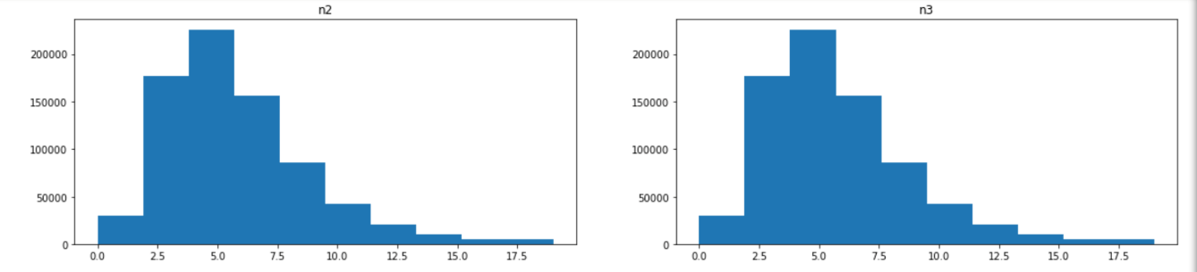
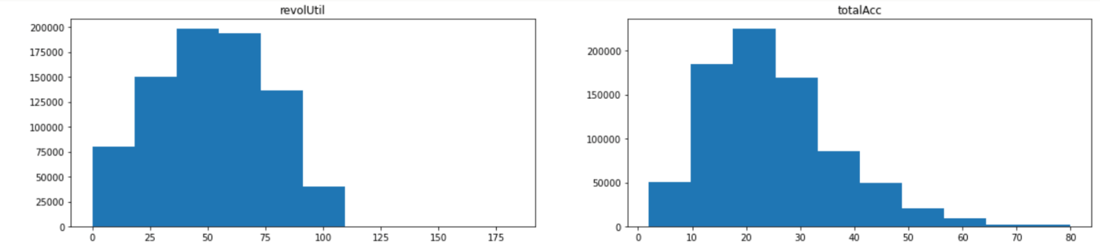
Processing numerical features
For the continuous type feature, we have 26 variables:
‘loanAmnt', 'interestRate','installment','annualIncome', 'dti','delinquency_2years','openAcc','pubRec','pubRecBankruptcies','revolBal','revolUtil','totalAcc','n0','n1','n3','n4','n5','n6','n7','n8','n9','n10','n11','n12','n13','n14'
Graphical representation of all the above features:

Slide 11
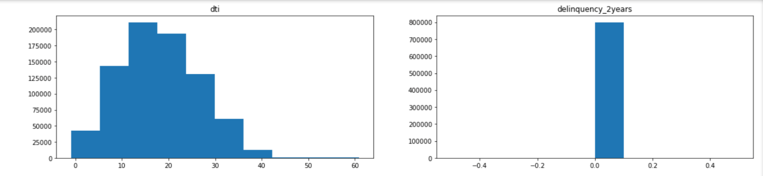
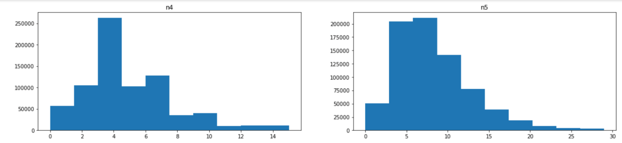
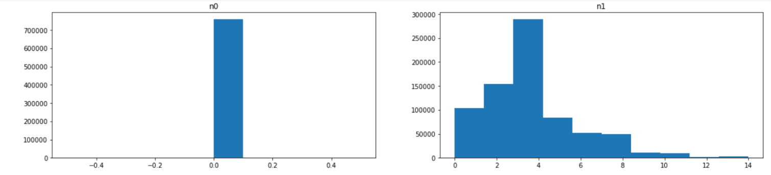
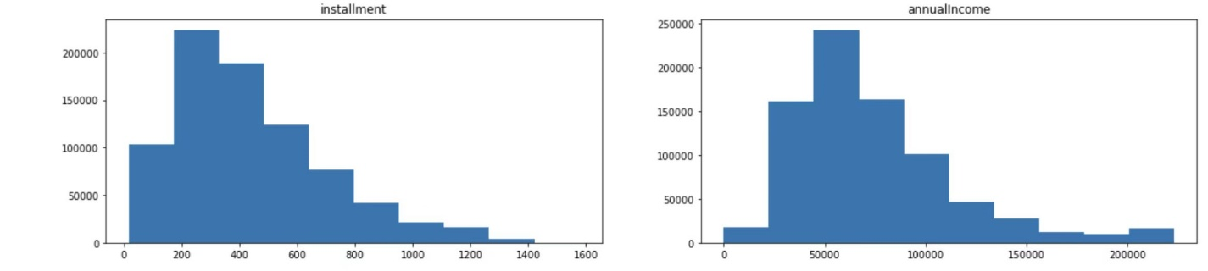
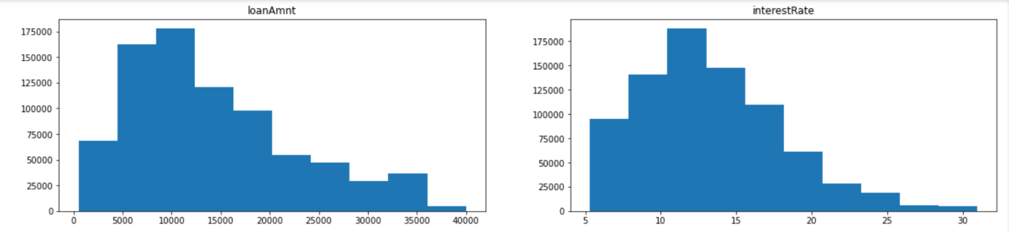
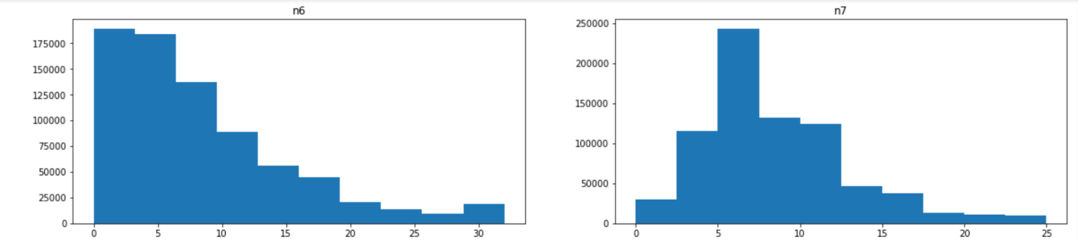
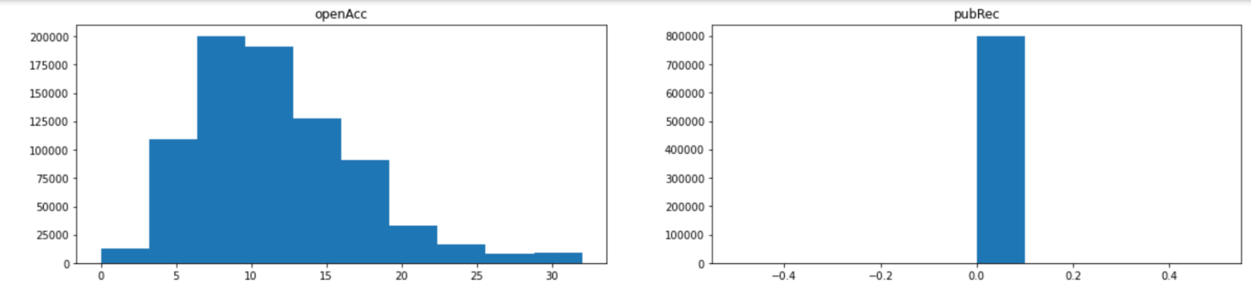
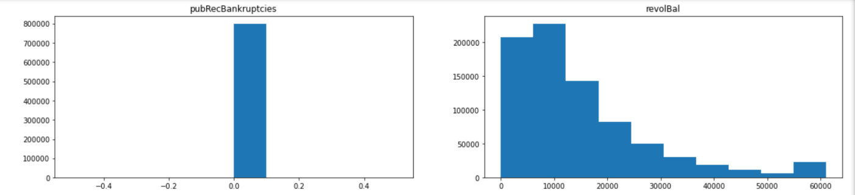

Slide 12
Processing numerical features
Outlier handling
we handle the outlier with method of truncation:
if there is a point higher or lower than upper quartile / lower quartile，
then we set this point as the Q3+(scale*IQR) or Q1+(scale*IQR)
Notes:
Cleaning outliers, a common practice in quantification is censoring. For each data, define two values, one big and one small, called the upper bound and the lower bound, and change the value greater than the upper bound in the data into the upper bound; change the value in the data less than the lower bound into the lower bound. There are two commonly used methods for defining upper and lower bounds, the quantile method or the standard deviation method.
Quantile method: Sort the data and take its quantile as the upper and lower bounds

Slide 13
Processing numerical features
Variable delete
Any data displayed as a single column in the distribution chart has only one value: 0. There is no research value and can be deleted directly.
Delete columns:
‘n11’,’n12’,’n13’,’n0’,’pubRecBankruptcies’,’pubRec’,’delinquency_2years’

Slide 14
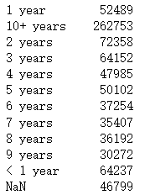
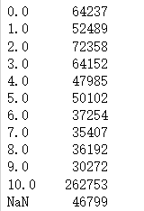
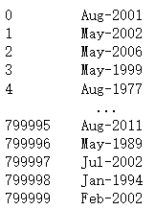
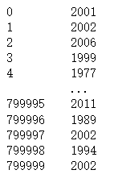
Processing categorical features
Handling of time formats
employmentLength： earliesCreditLine:
Notes:
Among the categorical features, we found that some features are in time format, which need to be processed before subsequent research can be carried out.
For employmentLength , we need to convert the categorical feature as numerical, and remove the following ‘years’
For earliesCreditLine, Due to the long time span, we only take the year and not the month.

Slide 15
Feature Engineering

Slide 16
Data binning
Purpose:
Feature binning is mainly to reduce the complexity of variables, reduce the impact of variable noise on the model.
Target:
Discretize continuous variables
Merge multi-state discrete variables into few states
Advantages of binning:
Handling missing values
Handling outliers
After feature discretization, the model will be more stable, reducing the risk of model overfitting
Notes:
After completing the data analysis and cleaning, we enter the feature engineering part.
First, we need to bin the data of continuous variables.
对advantage of binning的补充：
Handling missing values: When there may be missing values ​​in the data source, null can be used as a bin alone.
Handling outliers: When there are outliers in the data, they can be discretized by binning, thereby improving the robustness (anti-interference ability) of variables. For example, if there is an abnormal value such as 200 in age, it can be classified into the "age > 60" bin to exclude the influence.
After the features are discrete, the model is more stable. For example, if the continuous age is converted into the user age range, it will not change because the user's age is one year older.

Slide 17
Data binning
Chi-square box
It relies on the chi-square test: adjacent intervals with the smallest chi-square value are merged together until a certain stopping criterion is met.
We divide all the continuous variables into 6 group：
‘500.0-4450.0’
'4450.0-8400.0'
'8400.0-10375.0'
'10375.0-16300.0'
'16300.0-28150.0 '
'>=28150.0'
Loan Amount
35000.0
18000.0
12000.0
11000.0
3000.0
Loan Amount
>=28150.0
16300.0-28150.0
10375.0-16300.0
10375.0-16300.0
500.0-4450.0
Notes:
For example here, we divide the loanamout into 6 groups.

Slide 18
Feature construction
Feature construction is mainly to generate derivative variables.
We created the following derived variables:
Target default mean for grade and subgrade
Interest rate/Total Loan amount
Annual income/Total Loan amount
Installment amount/Total Loan amount
Annual Income / Installment Amount
Annual Income/ Years of employment (years)
Annual income * years of employment
openAcc/totalAcc
openAcc/earliesCreditLine
Notes:
对derivative 的解释：The so-called derivative variables refer to the processing and combination of features from the original data to generate new variables (new features) with commercial significance.
对openAcc/totalAcc的解释：The number of outstanding lines of credit in the borrower‘s credit file/The total number of credit lines currently in the borrower's credit file
对openAcc/earliesCreditLine的解释：The number of outstanding lines of credit in the borrower‘s credit file/The month in which the borrower's earliest reported line of credit was opened

Slide 19
Label encoding
transfer the ordinal category variables to a series of continuous integer, the model will handle this int series as continuous interger variables.( deal with regression method)
eg:
‘500.0-4450.0’ >>> 0
'4450.0-8400.0' >>> 1
'8400.0-10375.0' >>> 2
'10375.0-16300.0' >>> 3
'16300.0-28150.0 ' >>> 4
'>=28150.0' >>> 5
‘500.0-4450.0’ >>> 0
'4450.0-8400.0' >>> 1
'8400.0-10375.0' >>> 2
'10375.0-16300.0' >>> 3
'16300.0-28150.0 ' >>> 4
'>=28150.0' >>> 5
Loan Amount
>=28150.0
16300.0-28150.0
10375.0-16300.0
10375.0-16300.0
500.0-4450.0
Loan Amount
5
4
3
3
0

Slide 20
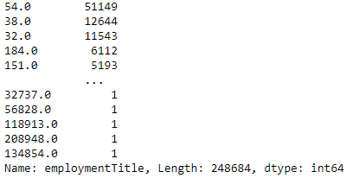
Label encoding
handle discrete/category variable with one-hot
Normally, we just set the discrete/category variable as the dummy variable with the one-hot way, however,
there are some parameter with to much variable.
eg:
employmenttitle frequency table:
248684 different variable
Take the top 100 frequency variables as unique dummy and the other variables just group as ‘else’.
Notes:
数据₊最后一句

Slide 21
Modeling

Slide 22
Model selection
Logistic regression model
Ensemble method
Bagging : Random Forest
Boosting: XgBoost ,LightGBM

Slide 23
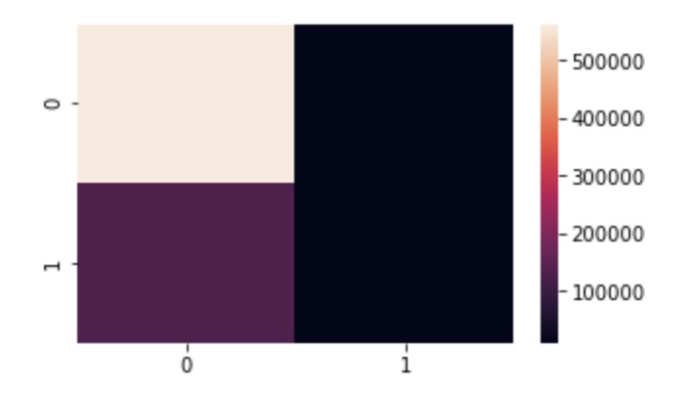
Logistic regression model
Take ‘isDefaulf’ as the target and put the rest of the features into the model as parameters.
Construct confusion matrix：
Visualize the confusion matrix, the lighter the color, the bigger the number
array( [ [ 562566, 9959 ], [ 130536, 10621] ] )

Slide 24
Logistic regression model
Use the ‘sklearn.metrics’ submodule ‘classification_report’ to quickly view the calculated values ​​of the confusion matrix precision, recall, and f1-score:
 | precision | recall | F1-score | Support
0 | 0.81 | 0.98 | 0.89 | 5272525
1 | 0.52 | 0.08 | 0.13 | 141157
accuracy |  |  | 0.80 | 713682
macro avg | 0.66 | 0.53 | 0.51 | 713682
weighted avg | 0.75 | 0.80 | 0.74 | 713682
Calculate the value of AUC：0.526772

Slide 25
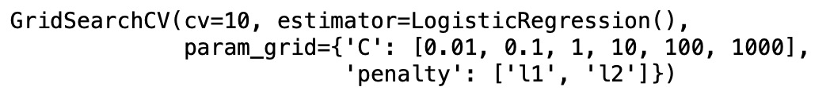
Logistic regression model
Model Evaluation and Optimization
We adopt the ‘GridSearchCV’ method in the sklearn module, which will combining cross-validation and grid search.
Construct different parameter combinations:
‘C’ is the reciprocal of the regularization coefficient λ , the smaller the value, the stronger the regularization.
‘penalty’ : regularization parameter
Notes:
In this project, we use the cross-validation method to divide the data set into three parts: training set, validation set and test set. Let the model learn on the training set, tune the parameters on the validation set, and finally evaluate the performance of the model using the test set data.
For model tuning, we use grid search to tune parameters. By constructing a parameter candidate set, grid search will exhaust various parameter combinations, and find the best set of settings according to the scoring mechanism of the set evaluation.

Slide 26

Logistic regression model
Plot the best parameters we got from ‘GridSearchCV’:
Apply best parameters to the model：
Area under the ROC curve:0.528924

Slide 27
Logistic regression model
Use ‘predicted_proba’ instead of ‘predict’, to predict the probability that 'isdefault’ = 1.
For the baseline model , we got AUC:
AUC_baseline: 0.70096104
Apply best parameters to the model：
AUC_tuning: 0.70114627

Slide 28
Random Forest model
Overview of the working process of random forests：
1.A subset of N samples is randomly selected from the dataset.
2.Build a decision tree based on these N sample subsets.
3.Choose the number of trees you want in your algorithm, and repeat steps 1 and 2.
Random Forest trains each decision tree on a different randomly selected subset of samples, then averages the predictions to make an overall prediction. This process is called bagging.

Slide 29
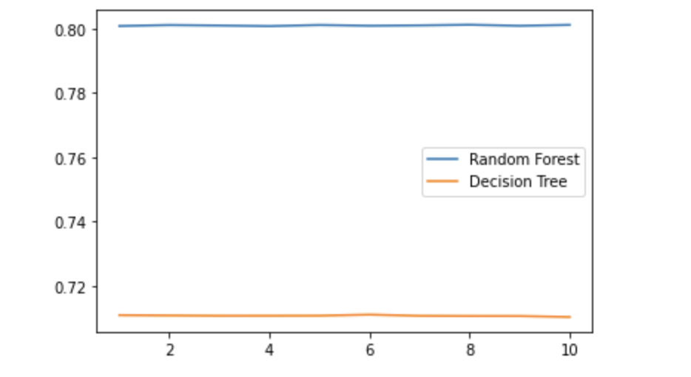
Random Forest model
Applying the data to a random forest model yields an accuracy of:
Single tree: 0.70903830
Random tree: 0.80366688
Draw a comparison of the effects of random forests and decision trees under a set of cross-validation
Notes:
Here we also apply the model to the decision tree model, and we can see that the random forest performs better than a single decision tree

Slide 30
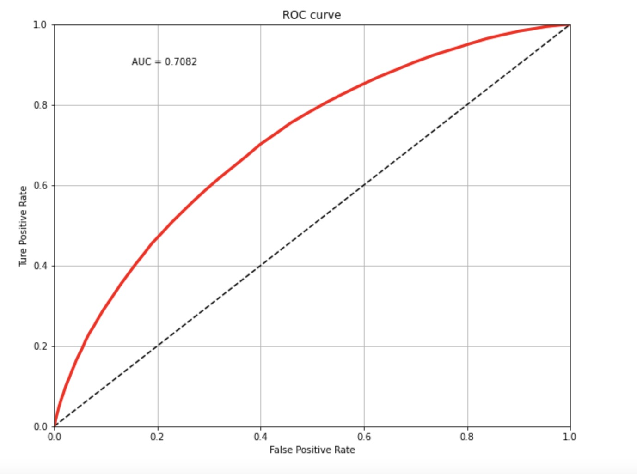
Random Forest model
Draw the ROC diagram of the random forest:
AUC:0.7082

Slide 31
Random Forest model
Model Evaluation and Optimization
The main parameters of random forest are ：‘n_estimators’, ‘max_depth’ ,‘min_samples_leaf’, ‘min_samples_split’, ‘max_features’.
Parameters adjustment ideas:
1.Drawing Learning Curve of n_estimators (most important)
2.Determine the best estimators
3.Use gridsearchcv to determine other parameters
Notes:
n_estimators (the number of subtrees)
max_depth (the maximum growth depth of the tree)
min_samples_leaf (the minimum number of samples of leaves),
min_samples_split (the minimum number of samples of branch nodes),
max_features (the maximum number of selected features)
The impact ranking is also as above.
对Parameters adjustment ideas的补充
But we are having trouble drawing the learning curve, the program takes a lot of time to run, when I run the code on kaggle, the server spends twelve hours and still no results, and kaggle after running the code for twelve hours will automatically log me out

Slide 32
xgb model:
Model Evaluation and Optimization
The main adjusting parameters of xgb are ：
‘max_depth’,‘min_child_weight’, ’subsample’, ’scale_pos_weight’, ’learning_rate’,’n_estimators’.
best parameters set:
learning_rate=0.2,max_depth=2,subsample=0.6,min_child_weight=1,colsample_bytree=0.7,scale_pos_weight=3,n_estimators=200
found that the adjusting parameters is really similar to the random forest, since they are both tree base model.

Slide 33
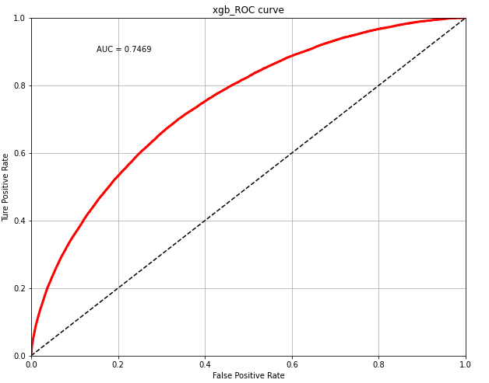
xgb model:
Performance in test set:
AUC=0.7269

Slide 34
Lgbt model:
Model Evaluation and Optimization
adjusting parameter ‘min_child_weight’,’num_leave’,’max_depth’,’learning_rate’ and so on
The algorithm logit is really similar between lgbt and xgbooting, so the adjusting parameter are almost the same.

Slide 35
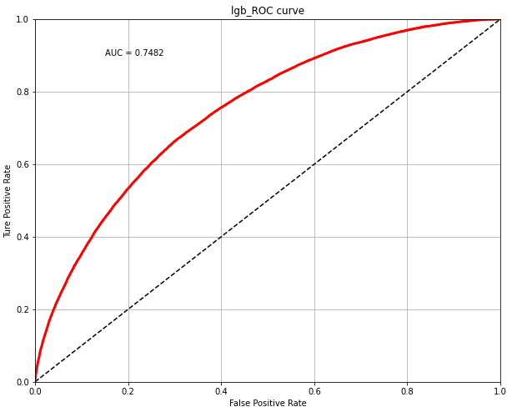
Lgbt model:
Performance in test set:
AUC=0.7282

Slide 36
Performance comparation:
Metrics: AUC
LGBT auc: 0.7282
Random forest auc: 0.7082
Logitregression auc: 0.7011
Xgboosting auc: 0.7269
LGBT model perform the best in this case

Slide 37
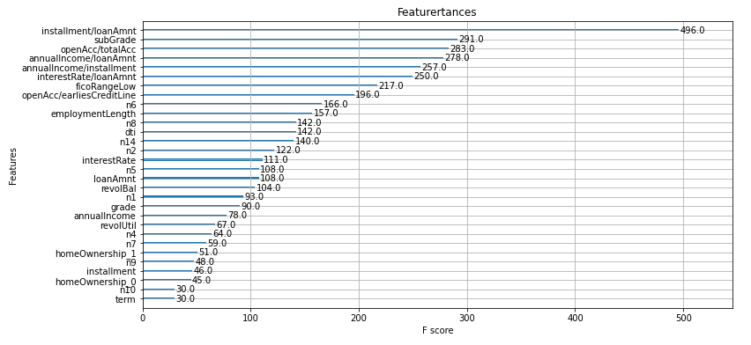
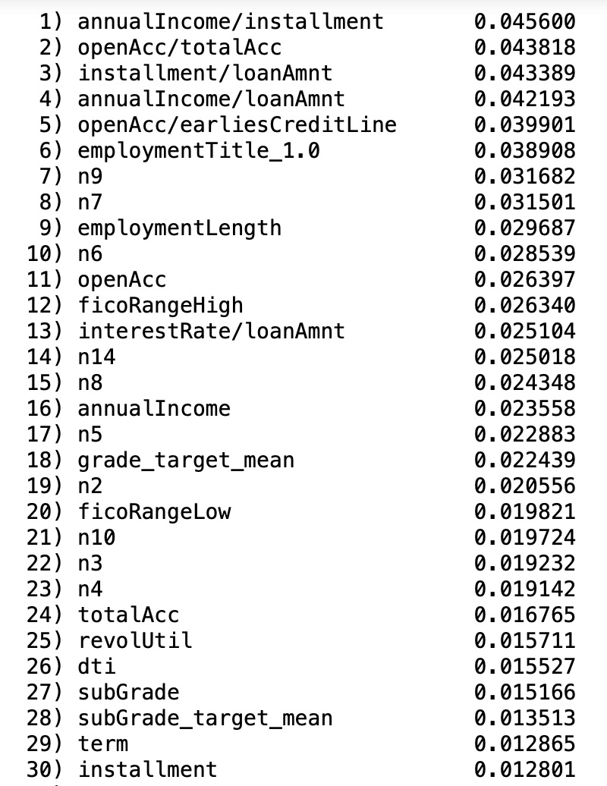
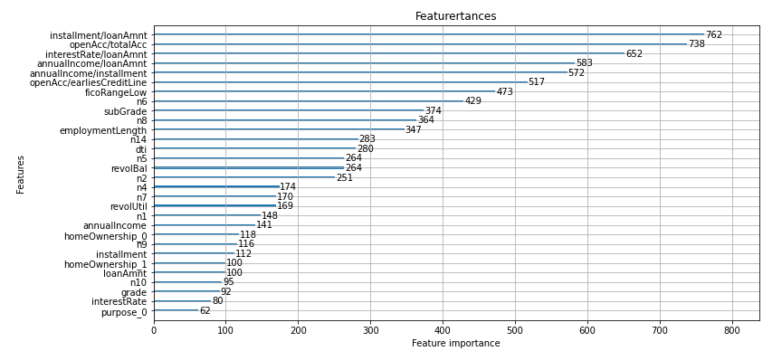
Importance Feature :
xgb model:
Random forest:
lgb model:

Slide 38
Importance Feature :
Which variables is important among three model?
for feature construction variable:
‘annualIncome / installment’, ‘openAcc / totalAcc’, ‘installment/loanAmnt’ , ‘annualIncome/ loanAmnt’ , ‘openacc / earliesCreditline’
for behavior count variable:
‘n6’ , ‘ n8 ’, ‘ n7 ’,’ n9 ’
for employment variable:
‘employmentLength’

Slide 39
Conclusion
the LGBT model perform the best in this project, with AUC 0.7482 and XGBoosting model is close to it with AUC 0.7469
The feature construction variables in feature engineering , like ‘annualIncome / installment’, show great important in the model performance, which is a great success.
We found some of the features are really helpful to make a default prediction, say, ‘n6’ , ‘n7’ , ‘n8’ , ‘n9’ , ‘employmentlenth’ and some of the feature we create.
Due to the insufficient computational power, we can not process the model stacking part which combine the model we mention and may highly improve the performance

Slide 40
Thanks for watching!

Slide 41
Addition for model stacking

Slide 42
conent:
How stacking work ?
How does the stacking perform in this case ?
What insight we can get from it ?

Slide 43
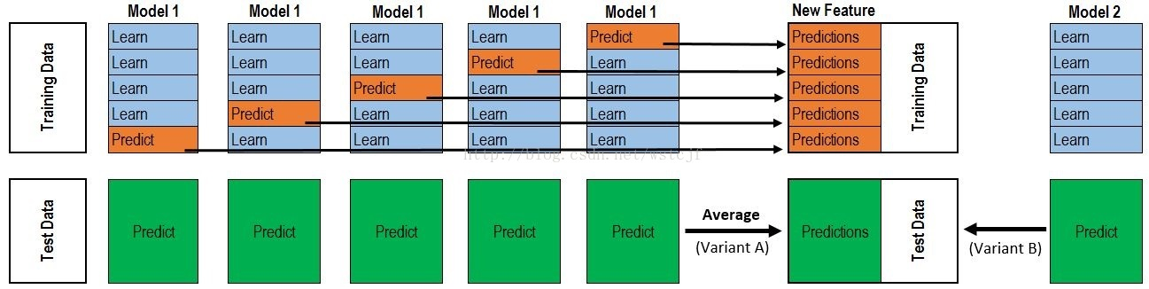
how stacking work ?
level 0:
there are two level in stacking, the following is level 0 part:
stacking is a way combine multiple base model together in order to make a better performance. imagine that there are two base model we gonna to combine, for the training data set, we take 5 fold-validation here, training 4 part and remaining 1 for predicting, then the model running for 5 time and generate 5 predictions which responding for every observation in training data set, then combine them together as a new feature for model 1. for each training model in model 1, also make a prediction for test data, and will generate 5 data set, then take the average of them , final generate the test prediction for model 1.
also process the model 2 as the same way, get the new feature for model2

Slide 44
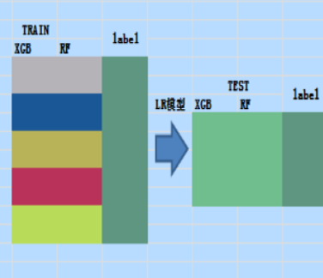
level 1 :
in level 1, first combine the previous new features together, generate a brand new train data set, also a new test data set.
assume that the previous base model is xgb and randomforest. And in level 1 we need a new method to train a model and predict, here we choose the logitregression model.
the model trained in level 1 we call it stacking model.
the model we choose in level 1 we call it meta-model.

Slide 45
how does the stacking perform in this case ?
due to the limitation of computational power, the stacking model train only 100000 observation. Also the base model include, xgboosting , lgbt , randomforest , Naive bayes and choose logitregression as meta model
performance :
LGBT auc: 0.72
Random forest auc: 0.71
Naive bayes auc : 0.64
Xgboosting auc: 0.71
Stacking Classifier auc : 0.64
it just interesting to find that the stacking model actually perform worse than the base model, after searching in internet, we do find some reason that may come to this result.

Slide 46
reason behind
stacking tends to do better with a larger number of input models than with a smaller number of ensembled models.
the base model is perform a relatively good job of fitting the data. So when you stack these base models, the potential for improvement over the best individual base model will likely be relatively small. In fact, it's quite possible that there's no improvement at all.
the stacking model do not perform well in every case, it depend on many different element.

